Slide 1
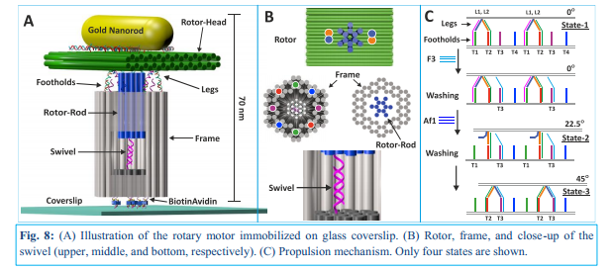
Imaging of Rotary Motor using TEM
Hadas Volkov
hadasvol@post.bgu.ac.il
11/16

Slide 2
Imaging of Rotary Motor using TEM
Objective: Using TEM imaging to verify motor parts and complete assembly of DNA structure.
Using TEM images in order to obtain averaging single particle images

Slide 3
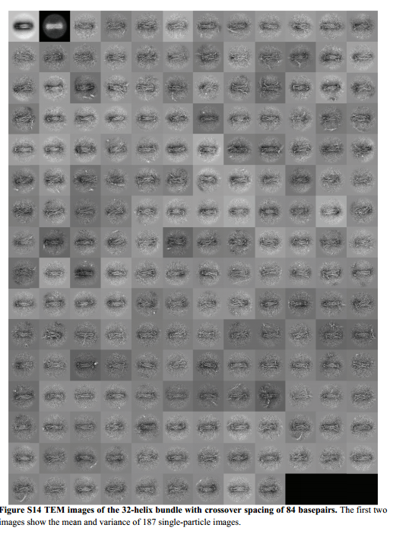
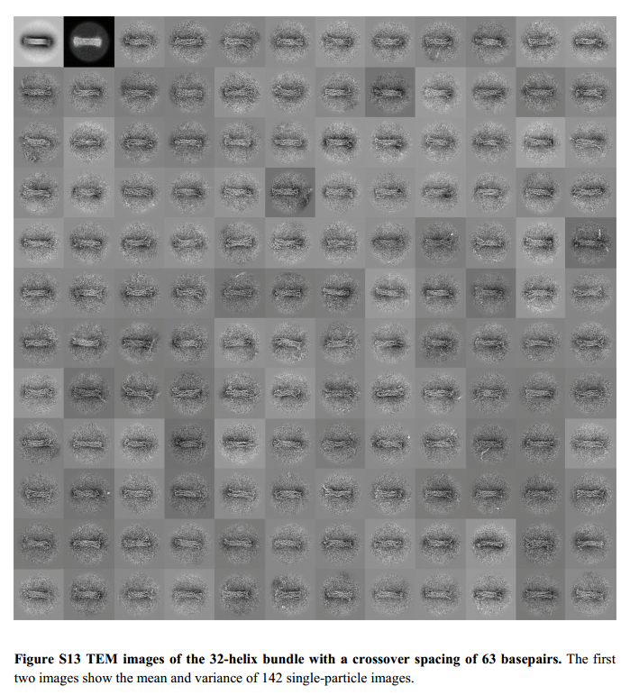
Literature examples Quantitative prediction of 3D solution shape and flexibility of nucleic acid nanostructures, H. Dietz, Nucleic Acids Research, 2011

Slide 4
TEM Sample preparation protocol Multilayer DNA Origami Packed on Hexagonal and Hybrid Lattices, W.M. Shih, JACS, 2011
TEM studies. The TEM sample was prepared by dropping 3.5µL of sample solution on a
carbon-coated grid (400 mesh, Ted pella). Before depositing the sample, the grids were
negatively glow discharged for 45 seconds. After 2 minutes, the sample was wicked from
the grid by touching its edge with a piece of filter paper. Then the grid was touched with
a drop of 2 % uranyl formate solution and excess solution was wicked away with a filter
paper. Again the grid was touched with a second drop of uranyl formate solution for 20
seconds, and the excess solution was removed with a filter paper. TEM studies were
conducted using a JEOL JEM-1400 transmission electron microscope, operated at 80 kV
on bright field mode.

